Slide 1
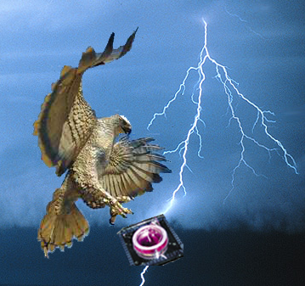
Using the 60 Channel MEA
Build 4.4 (08/05/2012)

Slide 2
Disclaimer
This data acquisition system is a work in progress.
The executable file is limited in scope and will be continuously upgraded
Any problems or questions, call Mary at 603-674-8882 or email to mtgjbird@hotmail.com

Slide 3
The Steps to Collecting Data
Sample Preparation
DAQ system set up
Recording Chamber set up
Microscope set up
Collecting Data (see last slide for abbreviated steps)
Exporting Data
Shutting down

Slide 4
Step 1: Sample Preparation
Clean the glass MEA recording chamber (according to manufacturer’s instructions) and disinfect (with 70 - 95% ethanol).
Coat the interior surface as needed with PLL or substrate of choice (indicated by the cell lines or tissue slice).
Perform all prep under aseptic conditions (ie in the hood, using sterile instruments and media).
Cover the recording chamber with sterile filter while transporting to the microscope and keep covered until recording.

Slide 5
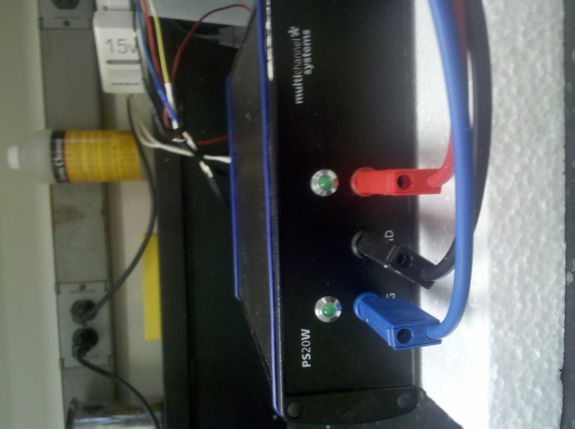
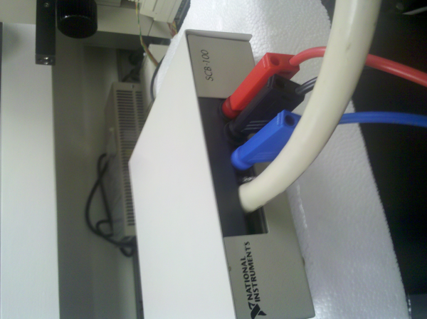
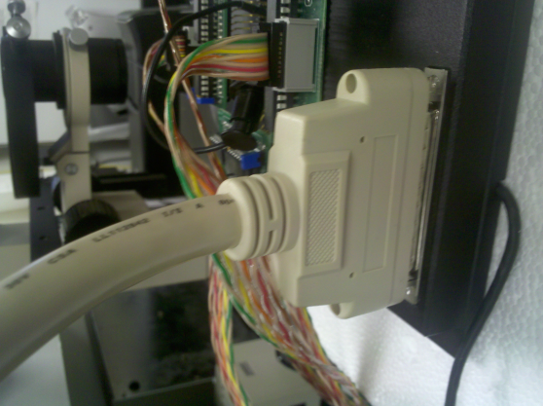
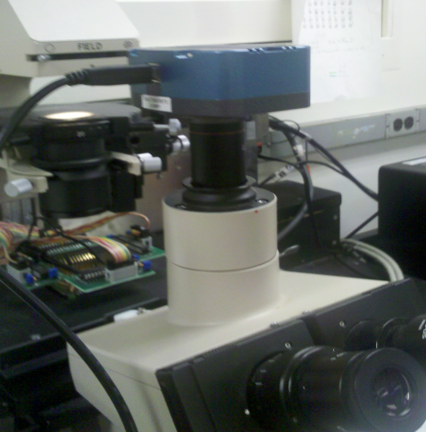
Step 2: DAQ Instrument Set Up
Check the connections to the various components:
Plug the three wires from the PS20W (blue, red, and black) into the corresponding ports on the SCB-100 connector box
Plug the 68-pin plug from the SCB-100 into the receptacle on the MEA recording amplifier/signal conditioner
Plug the USB cord from the blue eyepiece camera on the microscope into a USB port on the Dell Studio XPS computer. (This wire should come out of the camera in the direction of the door to the lab so that the sample images are aligned properly [this will be corrected programmatically at a later time]).

Slide 6
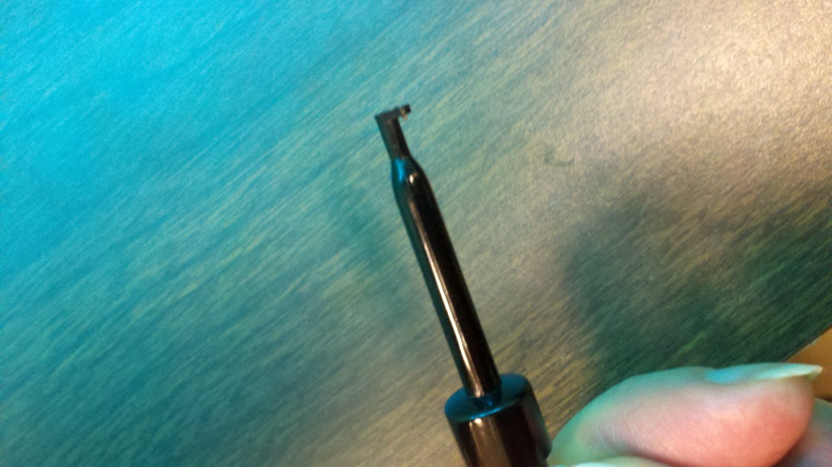
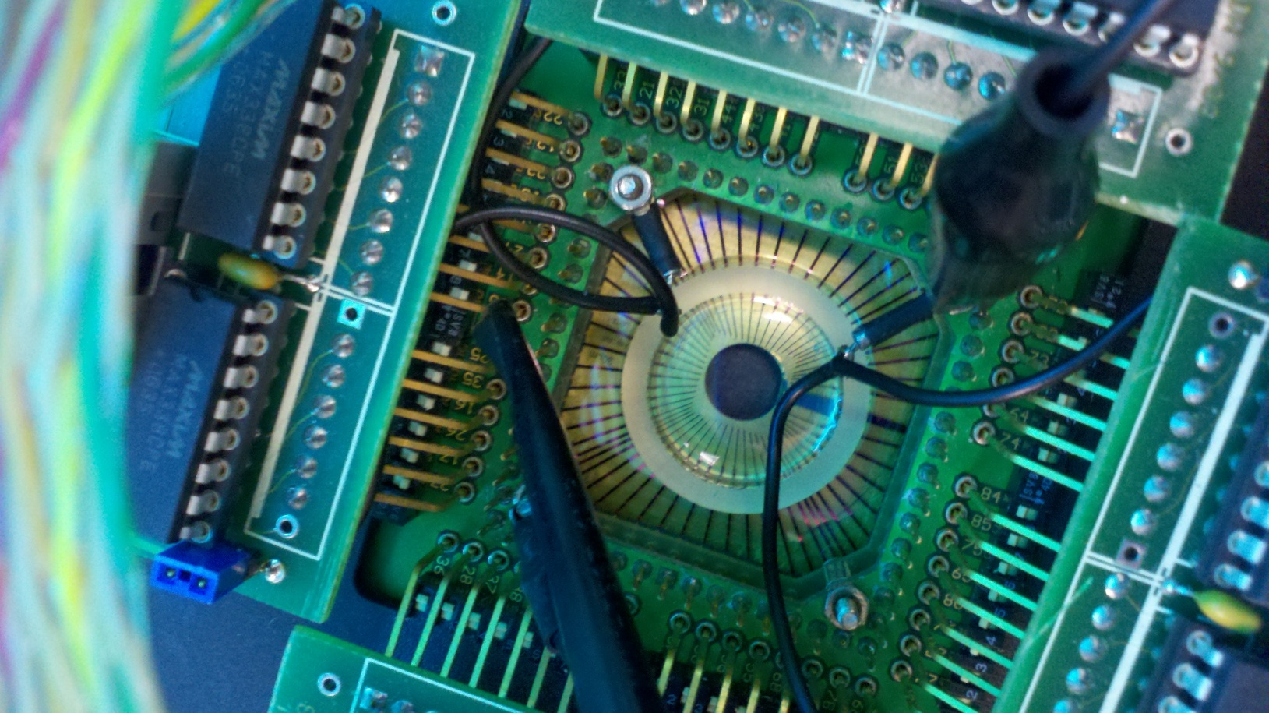
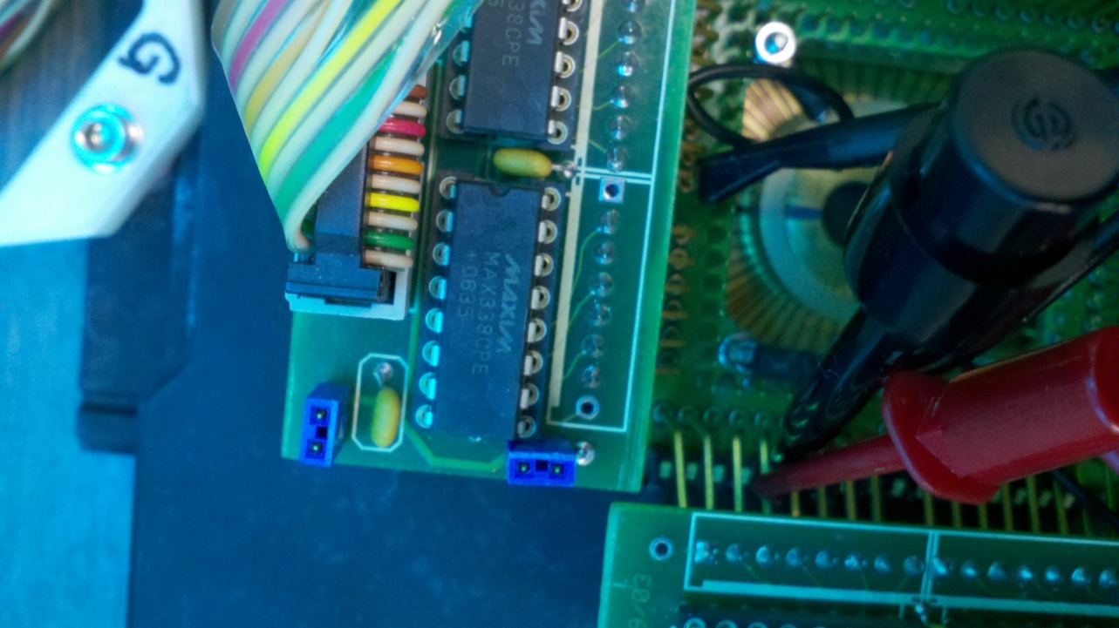
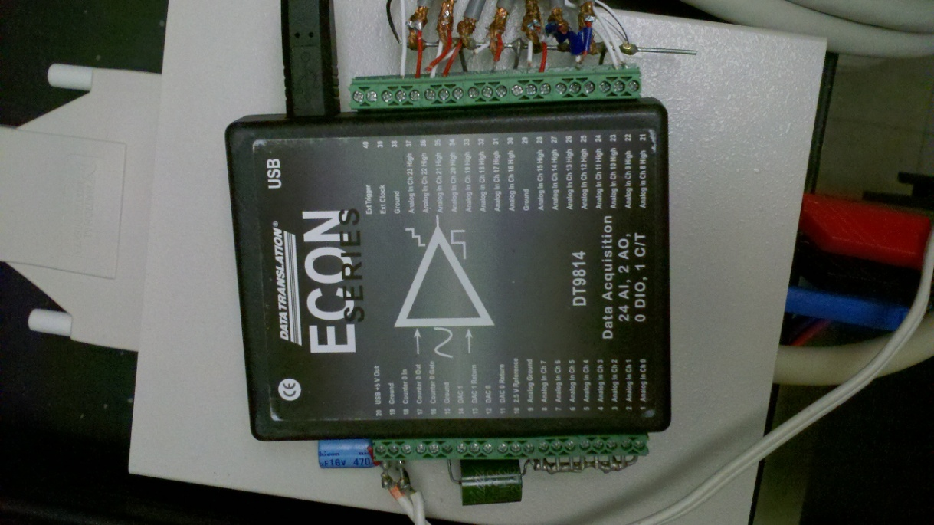
Step 2: DAQ Instrument Set Up (Stimulation System)
Plug the USB from the DT9814 (A) to a USB port on the computer.
There are two wires (one red, one black) attached to the “DAC0” and “DAC0 return” on the left side. They will connect to the MEA as follows: Connect the black spring hook (B) to the channel you want to stimulate on the MEA (C); Clip the alligator clip to another spring hook and clip that one to the channel next to the channel you are stimulating (D). For example, if you want to stimulate the electrode at 3,8, you would clip the second spring hook to 3,7 or 2,8, or 4,8
A
B
C
D

Slide 7
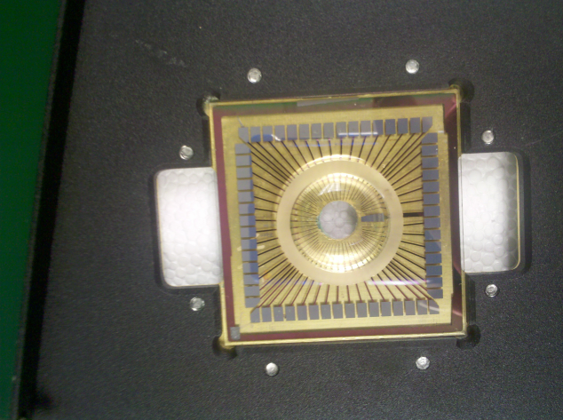
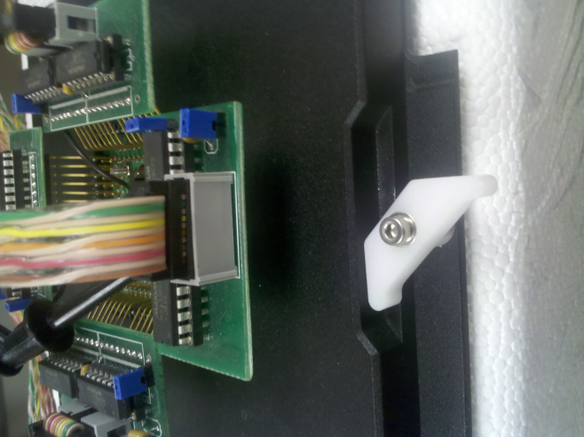
Step 3: Setting up Recording Chamber
Place the glass MEA recording chamber into the MEA amplifier/signal conditioner so that the thick line indicated in picture points away from you (towards the “G” that is written on the lever described in the next section).
Look at the underside of the top of the unit and make sure all pins are fully extended (they are spring-loaded and sometimes get stuck – if stuck, pull gently into position.) Carefully lower the top of the unit onto the glass MEA and lock using the 2 small levers.
Use care to avoid splashing media or buffer on the outside of the recording area on the glass MEA as this corrodes the electrodes.

Slide 8
Step 4: Setting up the Microscope (if acquiring images)
Place the MEA amplifier onto the microscope stage taking care to not break any wires. The 68 pin plug should be to the left side of the amplifier.
Turn on the microscope and move the stage so that the MEA is visible through the eyepieces. The knob on the right side of the Microscope should be set to “BI” or “OM.” Adjust the focus as necessary.

Slide 9
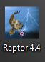
Step 5: Collecting Data
Turn on the outlet strip and the PS20W (the switch is on the backside of the unit).
Open the “Raptor 4.4” program by dbl-clicking on the Hawk icon on the desk top

Slide 10
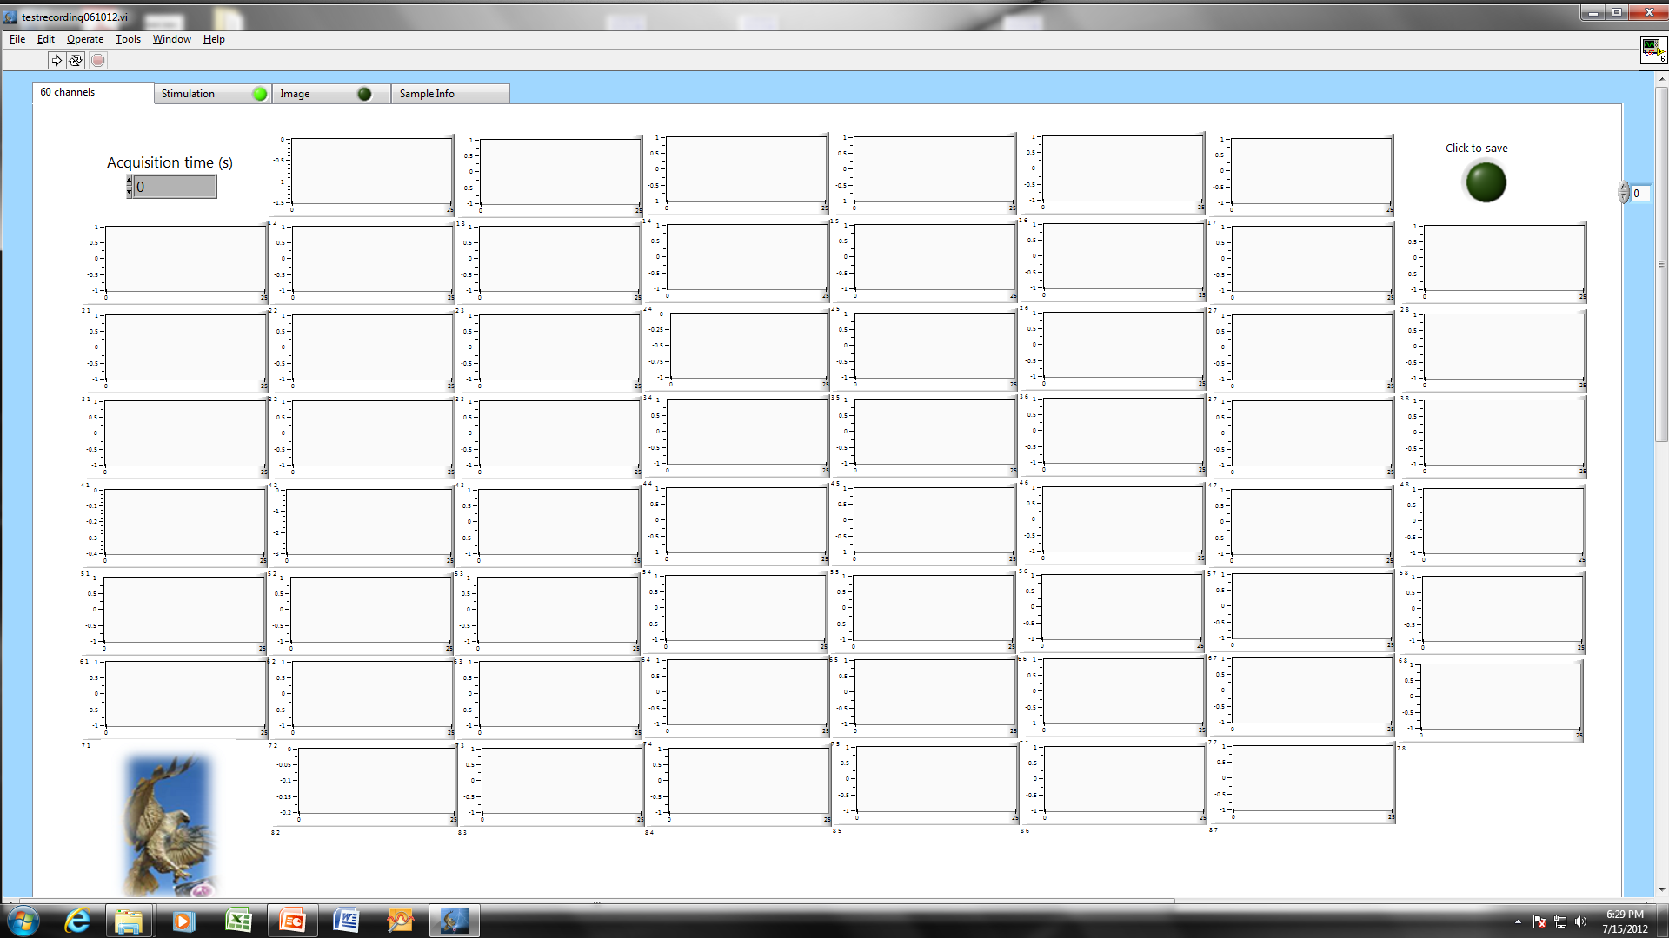
Step 5: Collecting Data (continued)
You should see a screen that looks like this:

Slide 11
Step 5: Collecting Data (control tabs)
When you open Raptor 4.4, there are 4 tabs available to set up your study. The first tab, “60 Channels,” is where you set up the acquisition time and collect all channels available, the 2nd tab, “Stimulation,” is for electrically stimulating a channel on the MEA with a user-defined voltage and waveform (and uses the DT9814 which gets connected to a USB port), the 3rd tab is for collecting Images (camera must be connected to USB port for this ), and the 4th tab is a large text box where you can add sample info. The 2nd, tab has a button that is by default, turned on and should be clicked off if you are not stimulating the MEA. The 3rd tab has a button that must be clicked in order to use those functions.

Slide 12
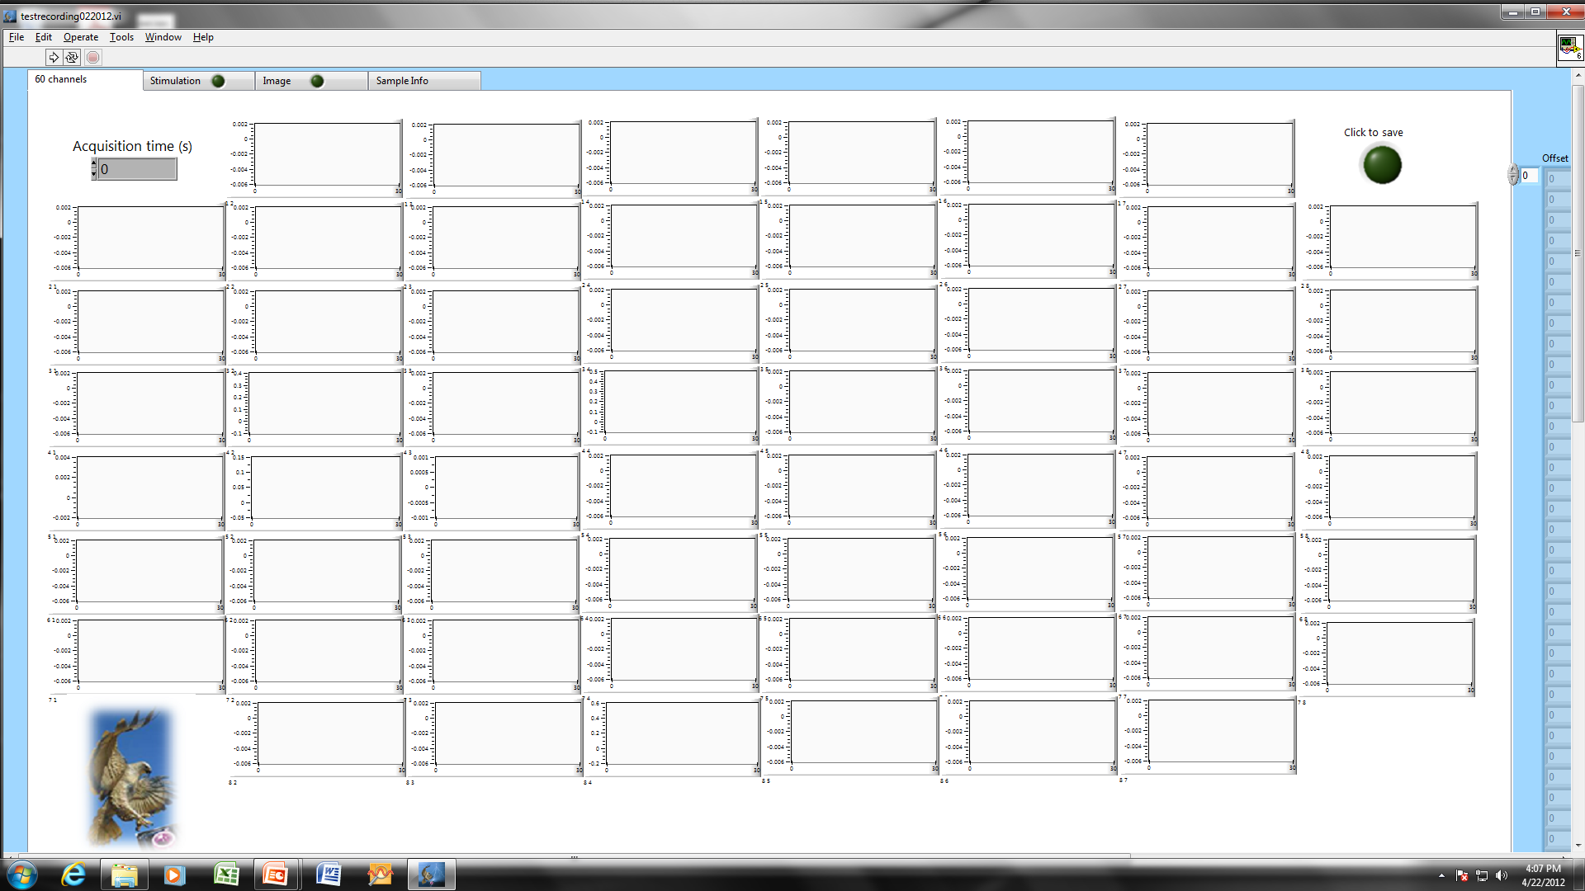
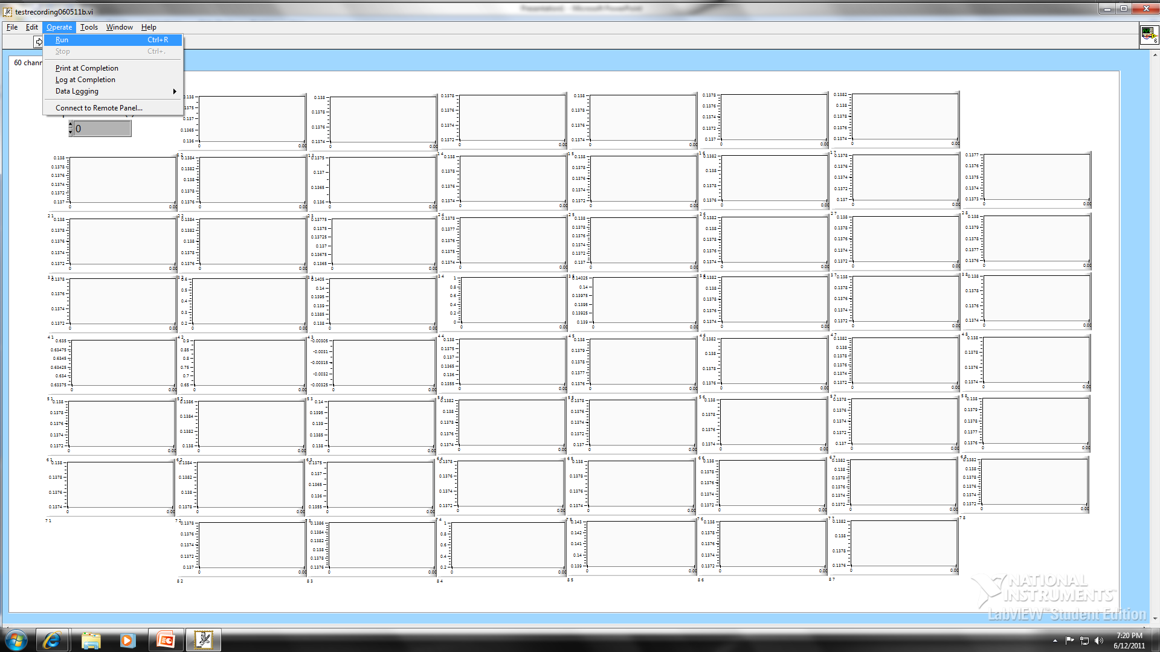
Step 5: Collecting Data (no stimulation)
Choose an acquisition time (type it in or use the arrows).
Click on the green button next to “Stimulation” to turn it off.
Click “Operate” and choose “Run”

Slide 13
Step 5: Collecting Data
(with Stimulation)
In the “60 Channels” tab, Choose an acquisition time (type it in or use the arrows)

Slide 14
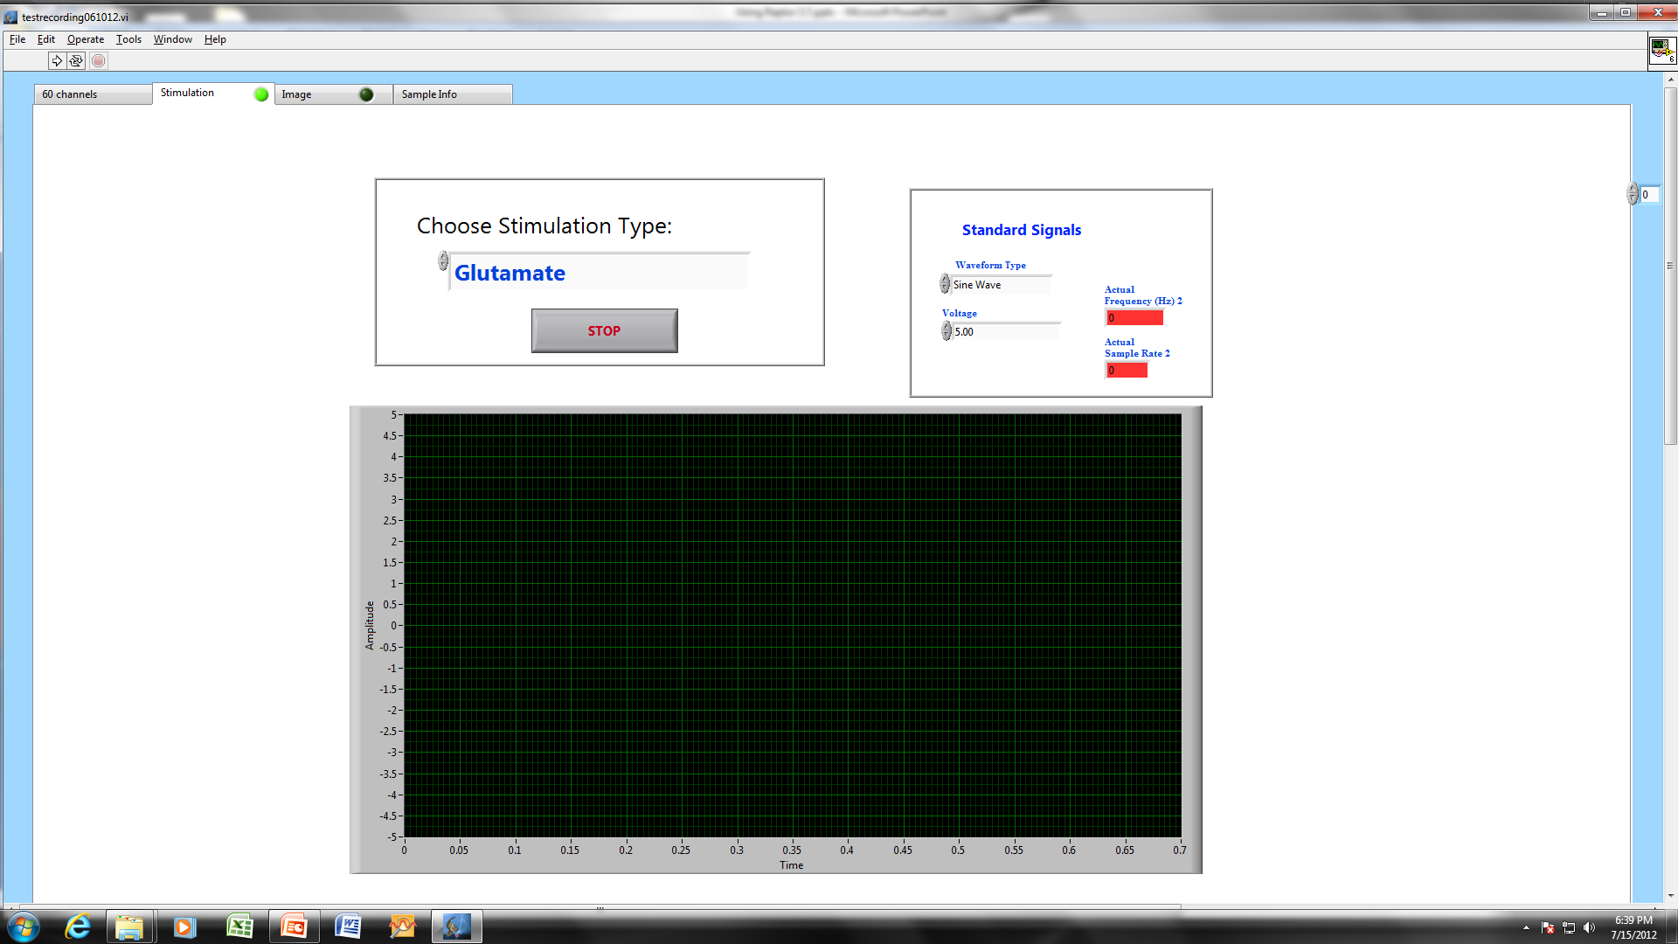
Step 5: Collecting Data (with Stimulation)
Click on the “Stimulation” Tab to get the following screen.

Slide 15
Step 5: Collecting Data (with Biological Signal Stimulation)
To Choose a Biological Signal, Choose the signal type using
these arrows
The current available biological signals include Glutamate, Synaptic, Inverted Synaptic, and Reverse Polarity Synaptic.
(see next slide for “Standard”)

Slide 16
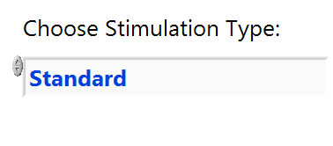
Step 5: Collecting Data (with Standard Signal Stimulation)
If you choose “Standard” (under “Choose Stimulation Type:”), you then have the option of choosing Sine, Square, Triangle, or Sawtooth under “Waveform Type”
Set the maximum voltage (it is a biphasic waveform so if you enter 0.1V, the range is -0.1 to 0.1V - note that the current settings have one cycle = 0.66 seconds. Maximum output is 2.4V so you will see artifacts if voltage greater than that is chosen.

Slide 17

Step 5: Collecting Data (with Stimulation)
Click “Operate” and choose “Run”
The stimulation will start at time of collection and must be stopped manually by clicking the “stop” button on the Stimulation screen. It will continue to stimulate until the DAC buffer is cleared so it may go for a few seconds (up to 5 seconds) after “stop” is pressed. If you need it to end sooner, just unplug the USB from the computer

Slide 18
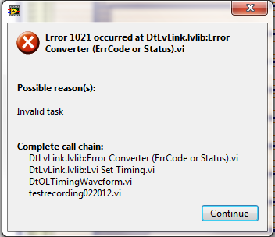
Step 5: Collecting Data (with Stimulation)
If you forget to plug in the DT9814, you will get an error that looks something like this:

Slide 19
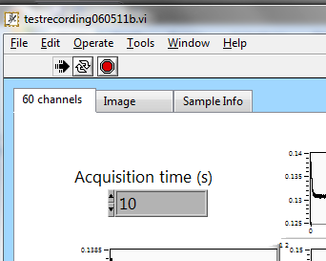
Step 5: Collecting Data (continued)
If you need to stop it before the chosen acquisition time is up, press the stop sign at any time (data will not save once the stop sign has been pressed).

Slide 20
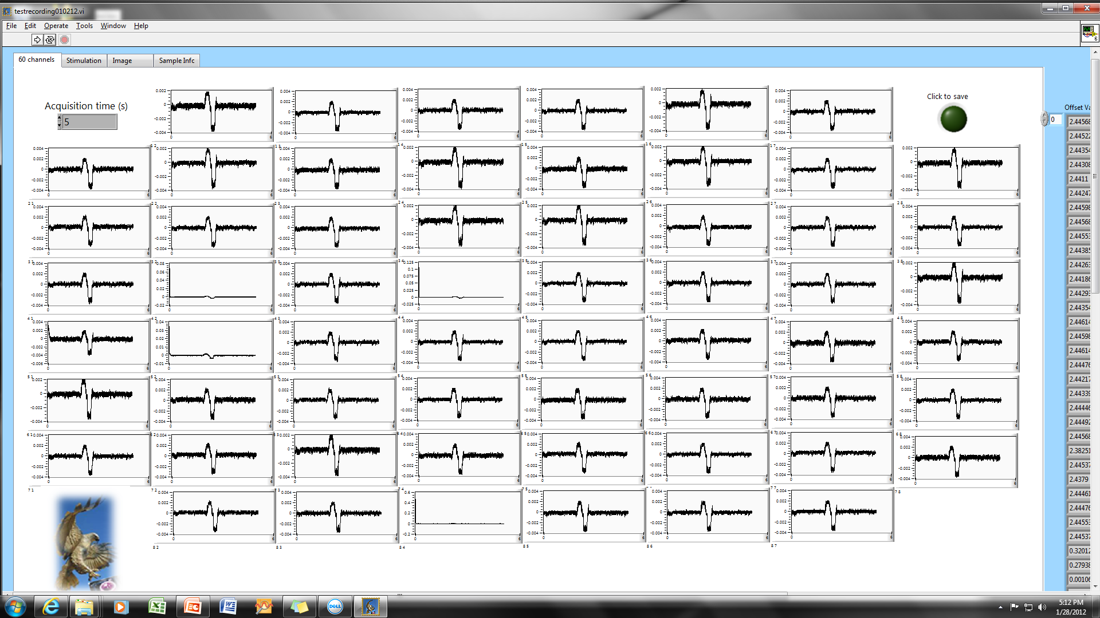
Step 6: Saving the Data
After the data has been collected, it will flash once and the background will automatically subtract. Click on the dark green “click to save” button (it will flash bright green) .

Slide 21
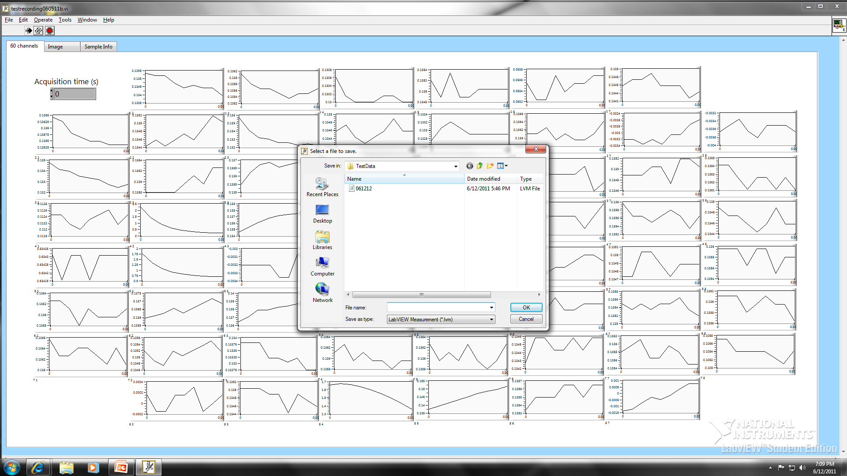
Step 6: Saving the Data (continued)
Choose a unique filename that contains enough information so you can recognize the file and type of study. Enter it into the box and click “OK.” This will happen twice – one file is an LVM file and the other is a TDMS file (for streaming).

Slide 22
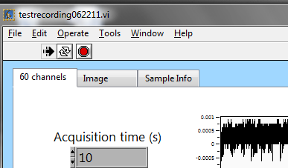
Step 6: Saving the Data (continued)
Click the stop sign after data has been saved

Slide 23
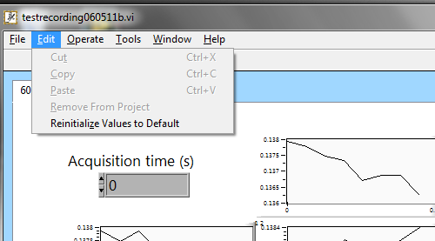
Step 7: Collecting Data from other samples
Click “Edit” and choose “Reinitialize Values to Default” then repeat steps 5 and 6 for the next samples

Slide 24
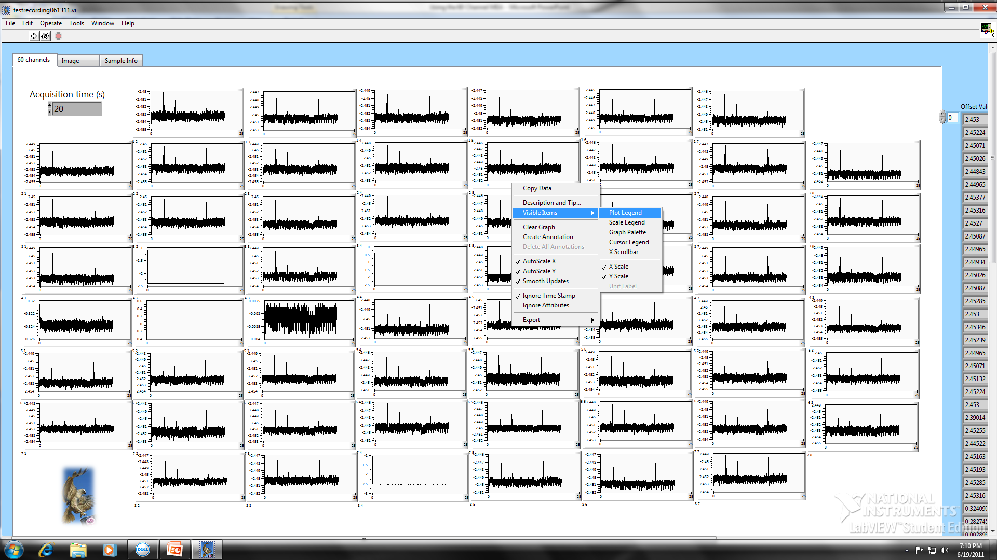
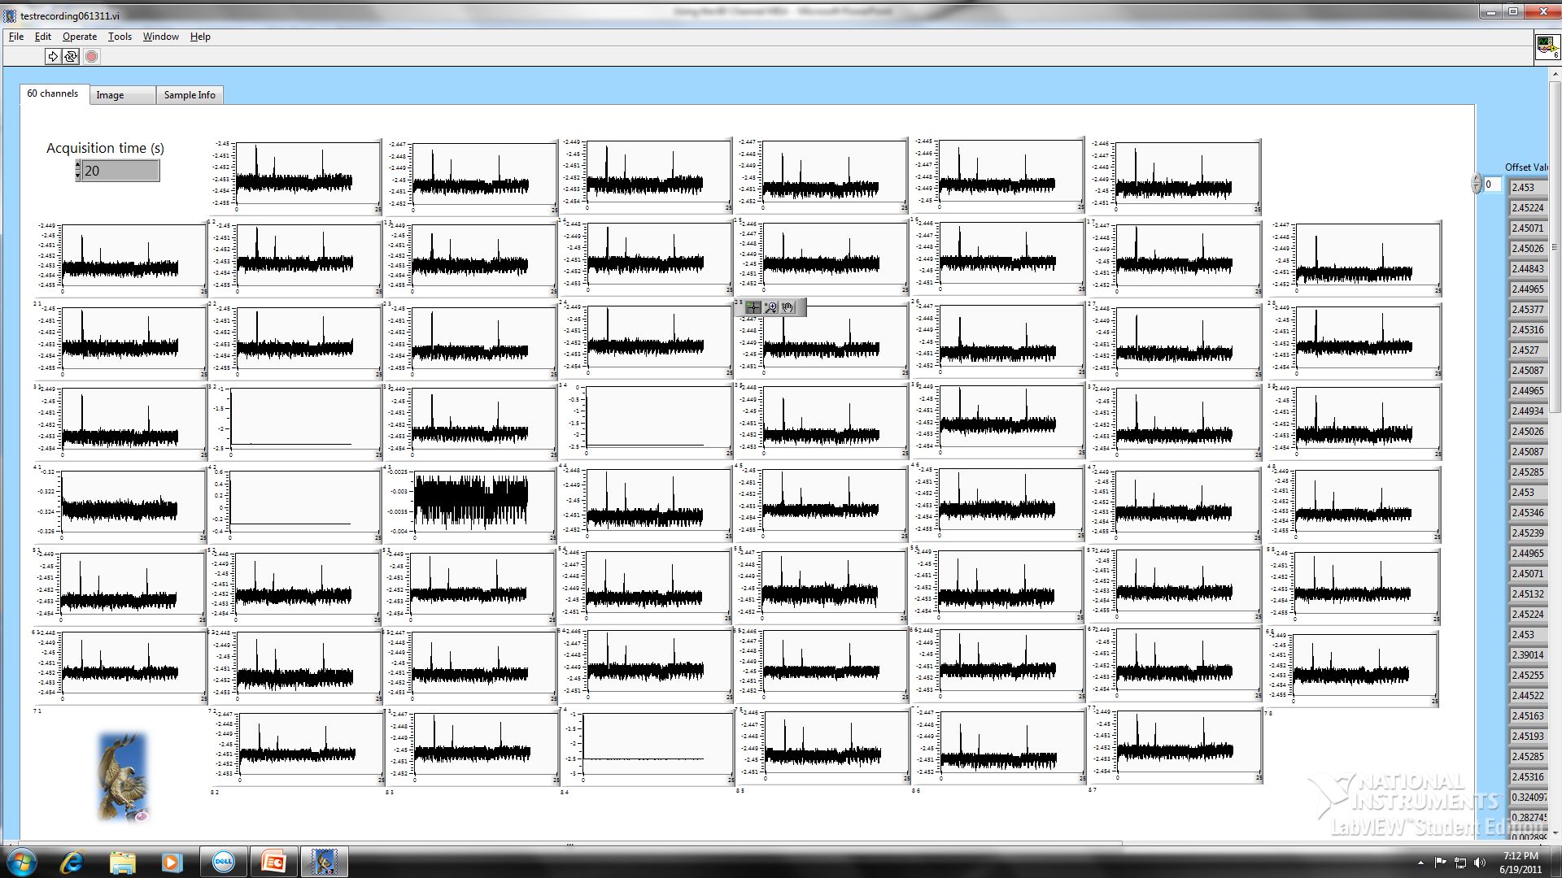
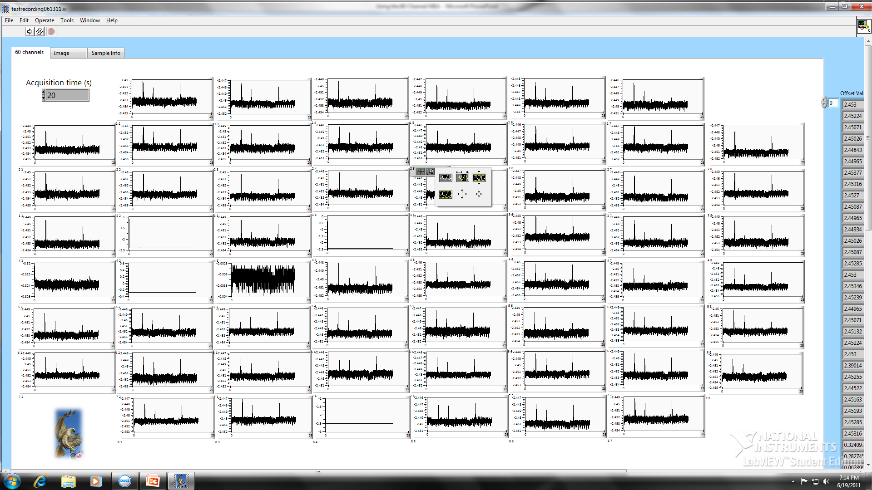
Step 8: Looking at Your Data
To get a closer look at any graph, right-click on it and choose “visible Items” and then “Graph Palette.” This give you the tools to zoom or stretch a graph while still in the Raptor program
Zoom control
Zoom opens this

Slide 25
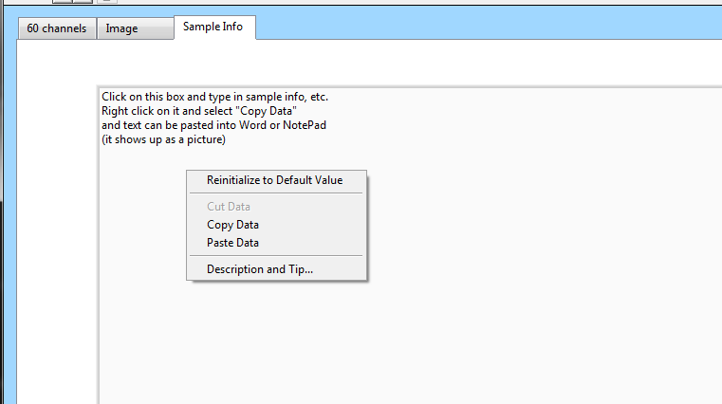
Other Features
Click the “Sample Info” Tab and you can insert text that describes the experiment or the samples. The output is currently a picture of the text. Later versions will have it exported as text.

Slide 26
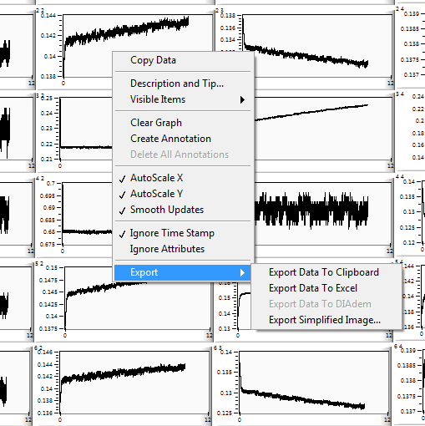
Step 9: Getting your Data (continued)
Individual graphs can be exported individually into Excel or as Images by right-clicking on the graph and choosing “Export”

Slide 27
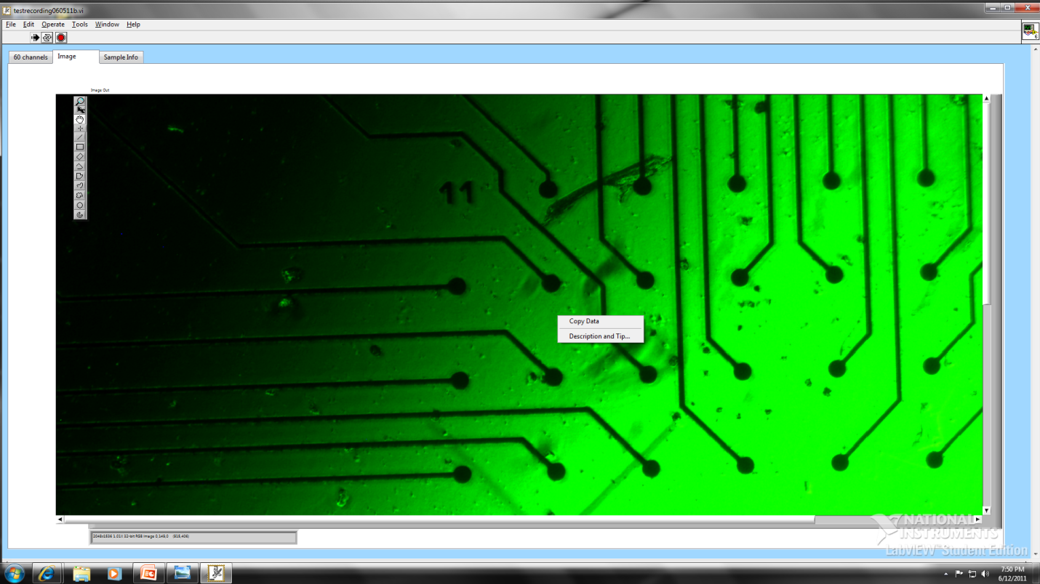
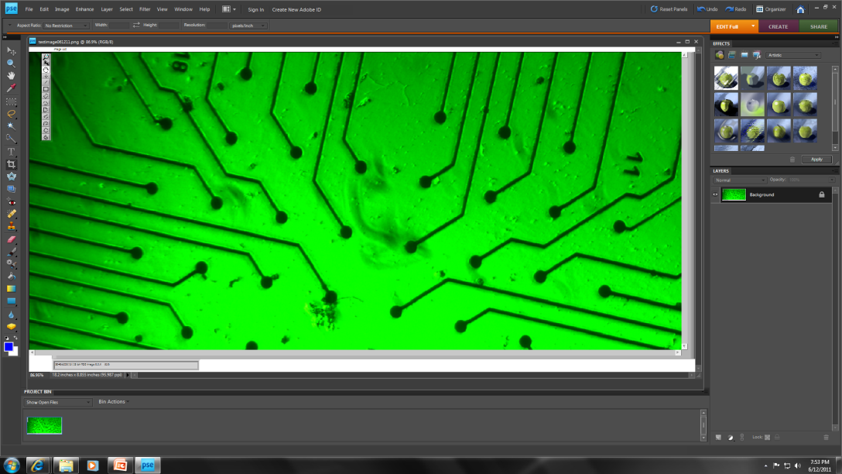
Step 9: Getting your Data (continued)
To get your image, click the Image Tab and then right click on the image, choose “Copy Data” and paste it (control+V) into Paint and save it. It then can be opened with any image analysis software (Photoshop Elements is shown).

Slide 28
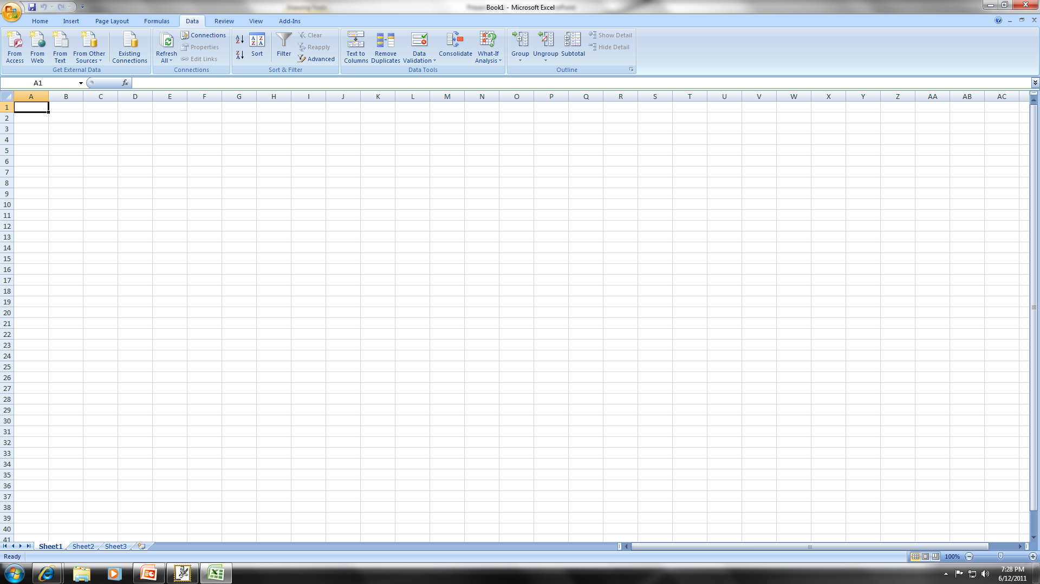
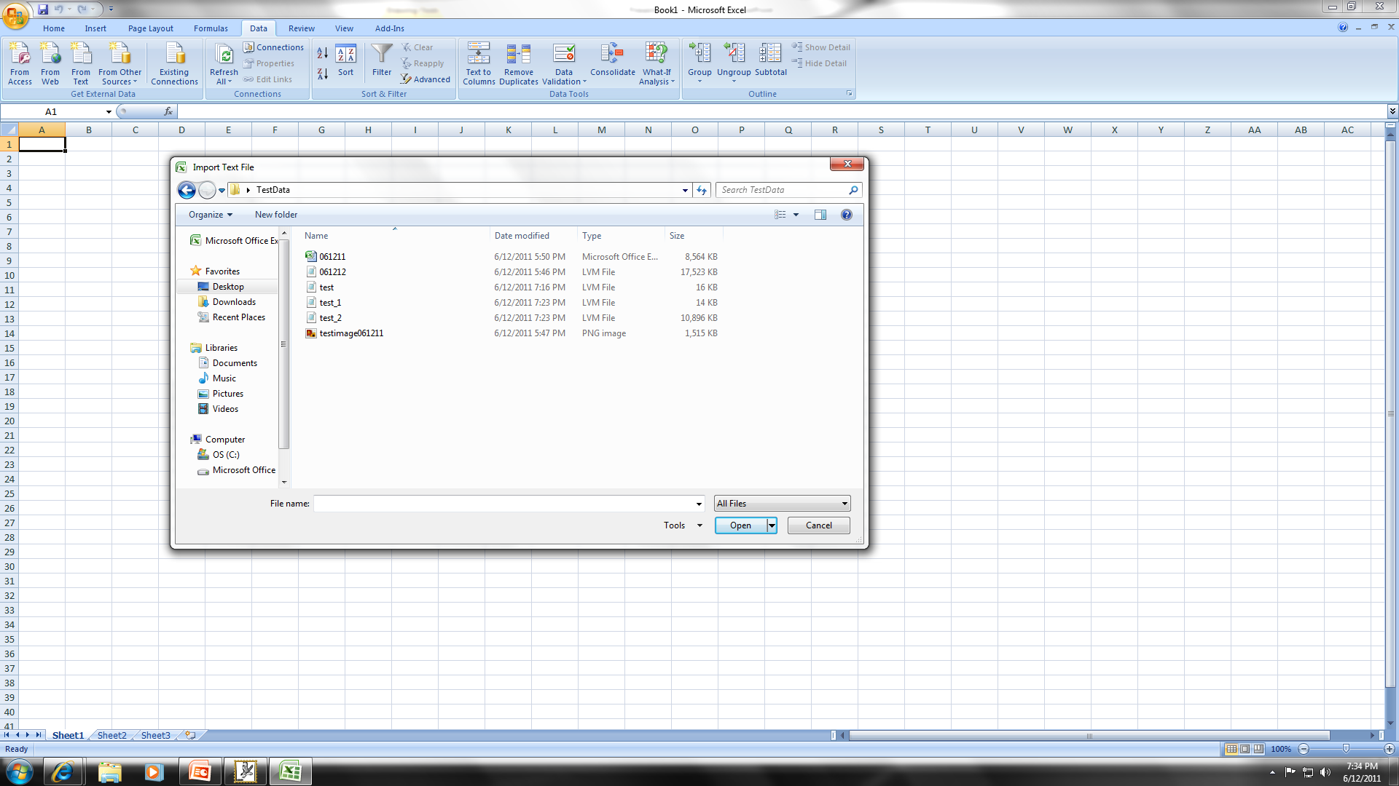
Step 10: Getting your Data (in EXCEL)
The data is saved automatically as an “.lvm” file – this is a kind of text file and the complete data set (excluding the images) can be opened into Excel using the import from text file option.
Open Excel, Click “Data” and choose “from text.” You will need to find the correct data file and change file type to “all files”
The file will be formatted with one X-column (time) and 60 Y-columns (each channel, labeled 0-59)

Slide 29
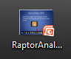
Getting your Data (in DIAdem)
DIAdem is a National Instruments program that is specifically designed to handle LabView files.
See “Raptor Analysis” powerpoint for details on how to use it

Slide 30
Step 11: Shutting Down
Check to make sure your data files collected and saved correctly.
Shut off the PS20W.
Remove the glass MEA recording chamber from the amplifier.
Shut off the microscope.
Shut down the computer.
Shut off the outlet strip

Slide 31
Abbreviated Data Collection Steps
Turn on PS20W
Click Hawk Icon (“Raptor 4.4”)
Choose an acquisition time
If stimulating, plug in USB from DT9814 and attach wires to MEA. Click on stimulation tab, and choose stimulation type (waveform type, and voltage if using standard stimulation types).
Click “Operate” and choose “Run”
Click “stop” on stimulation page to end stimulation or unplug USB.
Click the “click to save” button and choose a unique filename, save twice.
Press the stop button found in the header to stop the program after the data is saved (or any time you need to end an acquisition early)

Slide 32
Extra Slides: Program and Hardware set-up.

Slide 33
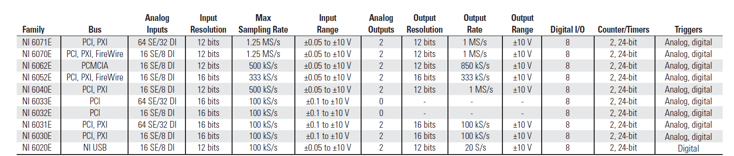
Hardware Set-up
DAQ card is National Instruments PCI-6033E
Driver is NI-DAQmx

Slide 34
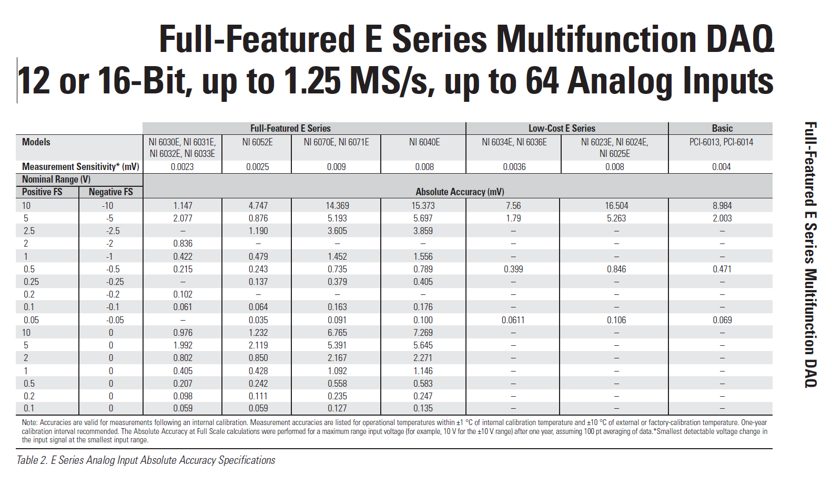
NI PCI-6033E Accuracy

Slide 35
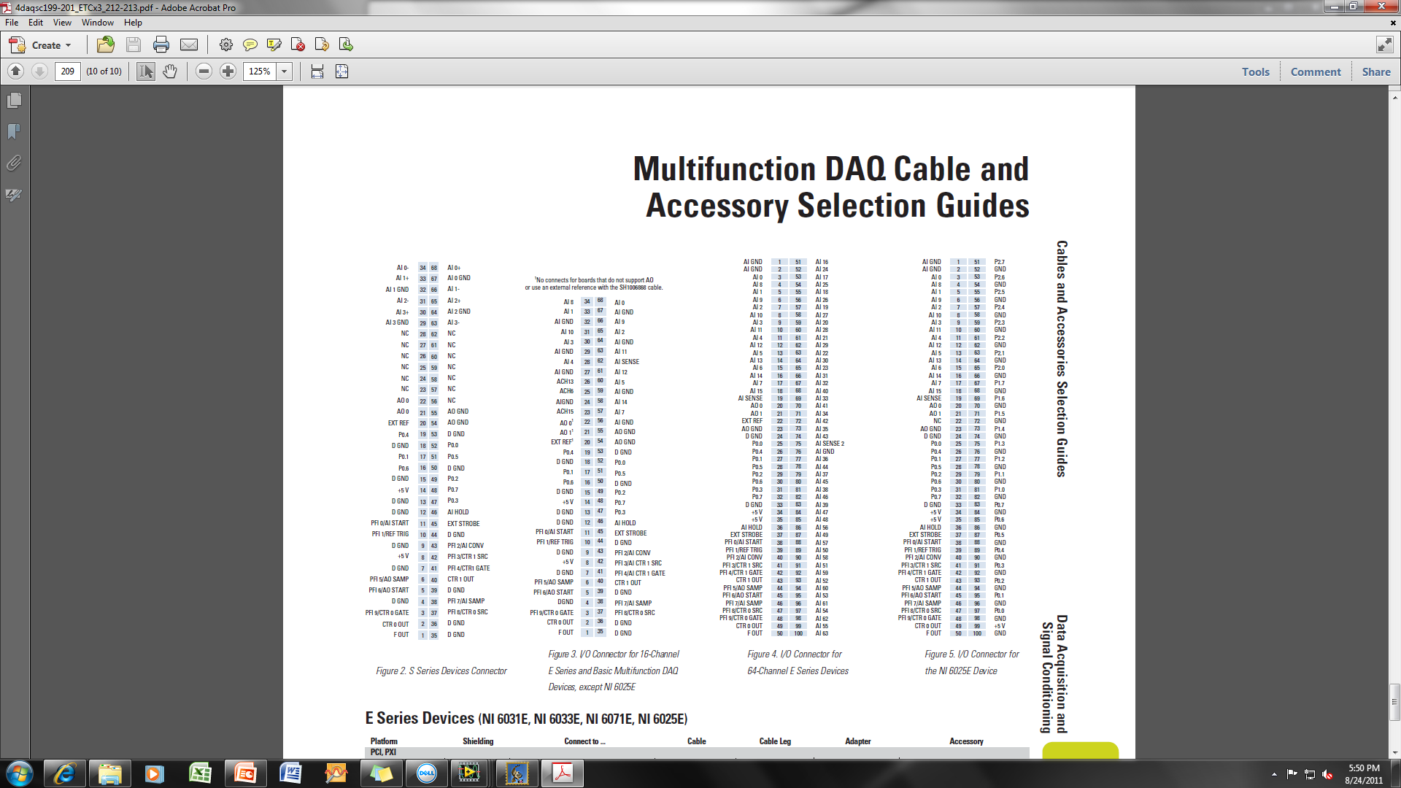
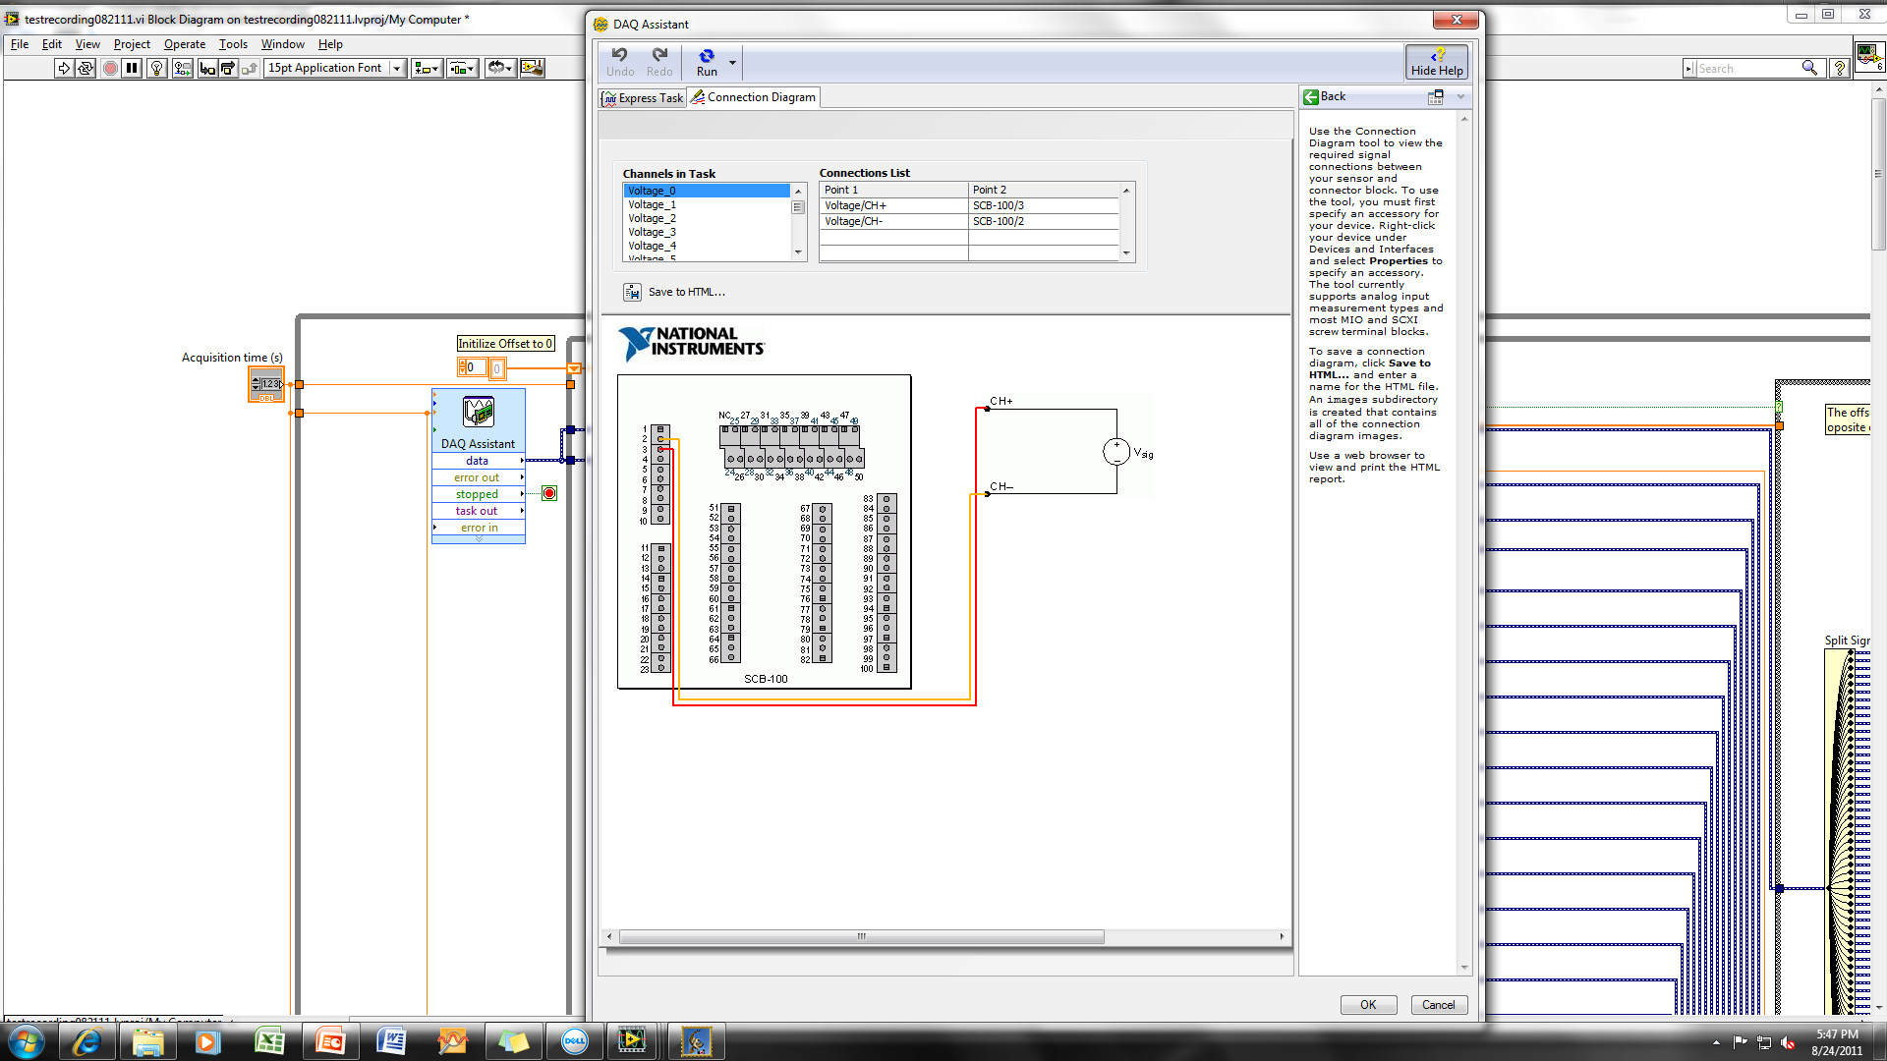
Wiring Diagram
PCI-6033E to SCB-100 connected via SH100100 cable
Wiring within SCB-100

Slide 36
Wiring Continued (see next slide for wiring from SCB100 to MEA1060)
Ai channel | mea | SCB100 | gnd | Ai channel | mea | SCB100 | gnd
0 | 21 | 3 | 2 | 30 | 15 | 64 | 76
1 | 31 | 5 | 2 | 31 | 25 | 66 | 76
2 | 41 | 7 | 2 | 32 | 35 | 67 | 76
3 | 51 | 9 | 2 | 33 | 45 | 69 | 76
4 | 61 | 11 | 2 | 34 | 55 | 71 | 76
5 | 71 | 13 | 2 | 35 | 65 | 73 | 76
6 | 12 | 15 | 2 | 36 | 75 | 77 | 76
7 | 22 | 17 | 2 | 37 | 85 | 79 | 76
8 | 32 | 4 | 2 | 38 | 16 | 81 | 76
9 | 42 | 6 | 2 | 39 | 26 | 83 | 76
10 | 52 | 8 | 2 | 40 | 36 | 68 | 76
11 | 65 | 10 | 2 | 41 | 46 | 70 | 76
12 | 72 | 12 | 2 | 42 | 56 | 72 | 76
13 | 82 | 14 | 2 | 43 | 66 | 74 | 76
14 | 13 | 16 | 2 | 44 | 76 | 78 | 76
15 | 23 | 18 | 2 | 45 | 86 | 80 | 76
16 | 33 | 51 | 76 | 46 | 17 | 82 | 76
17 | 43 | 53 | 76 | 47 | 27 | 84 | 76
18 | 53 | 55 | 76 | 48 | 37 | 85 | 76
19 | 63 | 57 | 76 | 49 | 47 | 87 | 76
20 | 73 | 59 | 76 | 50 | 57 | 89 | 76
21 | 83 | 61 | 76 | 51 | 67 | 91 | 76
22 | 14 | 63 | 76 | 52 | 77 | 93 | 76
23 | 24 | 65 | 76 | 53 | 87 | 95 | 76
24 | 34 | 52 | 76 | 54 | 28 | 97 | 76
25 | 44 | 54 | 76 | 55 | 38 | 99 | 76
26 | 54 | 56 | 76 | 56 | 48 | 86 | 76
27 | 64 | 58 | 76 | 57 | 58 | 88 | 76
28 | 74 | 60 | 76 | 58 | 68 | 90 | 76
29 | 84 | 62 | 76 | 59 | 78 | 92 | 76

Slide 37
Wiring Continued
Ai channel |  |  |  | 37 | 34 | 44 | 43 | 59 | 58 | 50 | 56 | 41 | 48 | 47 | 46 | 39 | 32 | 31 | 22 | 25 | 15 | 16 | 0 | 1 | 9 | 3 | 18 | 11 | 12 | 13 | 21 | 27 | 28
mea |  |  |  | 58 | 55 | 67 | 66 | 87 | 86 | 75 | 84 | 64 | 73 | 72 | 71 | 62 | 53 | 52 | 41 | 44 | 32 | 33 | 21 | 31 | 42 | 51 | 53 | 65 | 72 | 82 | 83 | 64 | 74
scb100 |  |  |  | 79 | 71 | 78 | 74 | 92 | 90 | 89 | 86 | 70 | 85 | 84 | 82 | 83 | 67 | 66 | 63 | 54 | 18 | 51 | 3 | 5 | 6 | 9 | 55 | 10 | 12 | 14 | 61 | 58 | 60
pinsocket | 67 | 65 | 63 | 61 | 59 | 57 | 55 | 53 | 51 | 49 | 47 | 45 | 43 | 41 | 39 | 37 | 35 | 33 | 31 | 29 | 27 | 25 | 23 | 21 | 19 | 17 | 15 | 13 | 11 | 9 | 7 | 5 | 3 | 1
pinsocket | 68 | 66 | 64 | 62 | 60 | 58 | 56 | 54 | 52 | 50 | 48 | 46 | 44 | 42 | 40 | 38 | 36 | 34 | 32 | 30 | 28 | 26 | 24 | 22 | 20 | 18 | 16 | 14 | 12 | 10 | 8 | 6 | 4 | 2
Ai channel |  |  |  | 36 | 35 | 45 | 53 | 52 | 51 | 42 | 57 | 49 | 55 | 54 | 40 | 39 | 33 | 30 | 23 | 24 | 14 | 6 | 7 | 8 | 17 | 2 | 10 | 4 | 5 | 19 | 20 | 26 | 29
mea |  |  |  | 75 | 65 | 86 | 87 | 77 | 67 | 56 | 58 | 47 | 38 | 28 | 36 | 26 | 45 | 15 | 24 | 34 | 13 | 83 | 22 | 32 | 43 | 41 | 52 | 61 | 71 | 63 | 73 | 54 | 84
scb100 |  |  |  | 77 | 73 | 80 | 95 | 93 | 91 | 72 | 88 | 87 | 99 | 97 | 68 | 83 | 69 | 64 | 65 | 52 | 16 | 15 | 17 | 4 | 53 | 7 | 8 | 11 | 13 | 57 | 59 | 56 | 62
unused
grounds
Power supply + and -
Ai channel = number of channel on PCI card and LabView block diagram
mea = location on MEA array (see below and next slide)
pin socket = connection at MEA1060 amplifier
This is the pin diagram on the amplifier

Slide 38
Channel Map

Slide 39
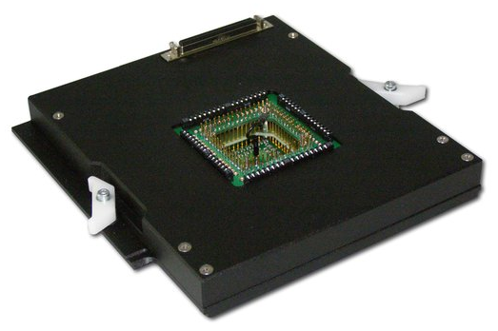
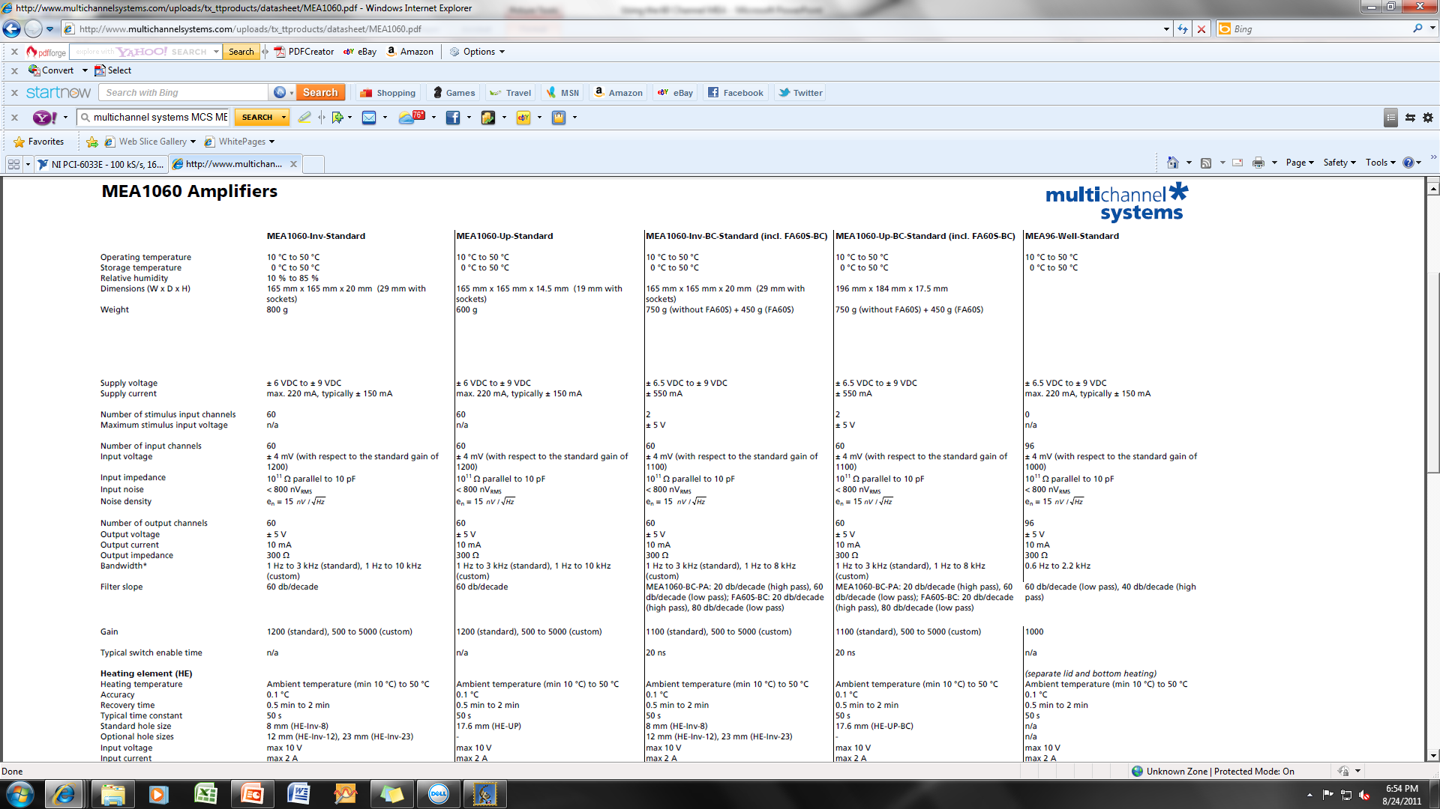
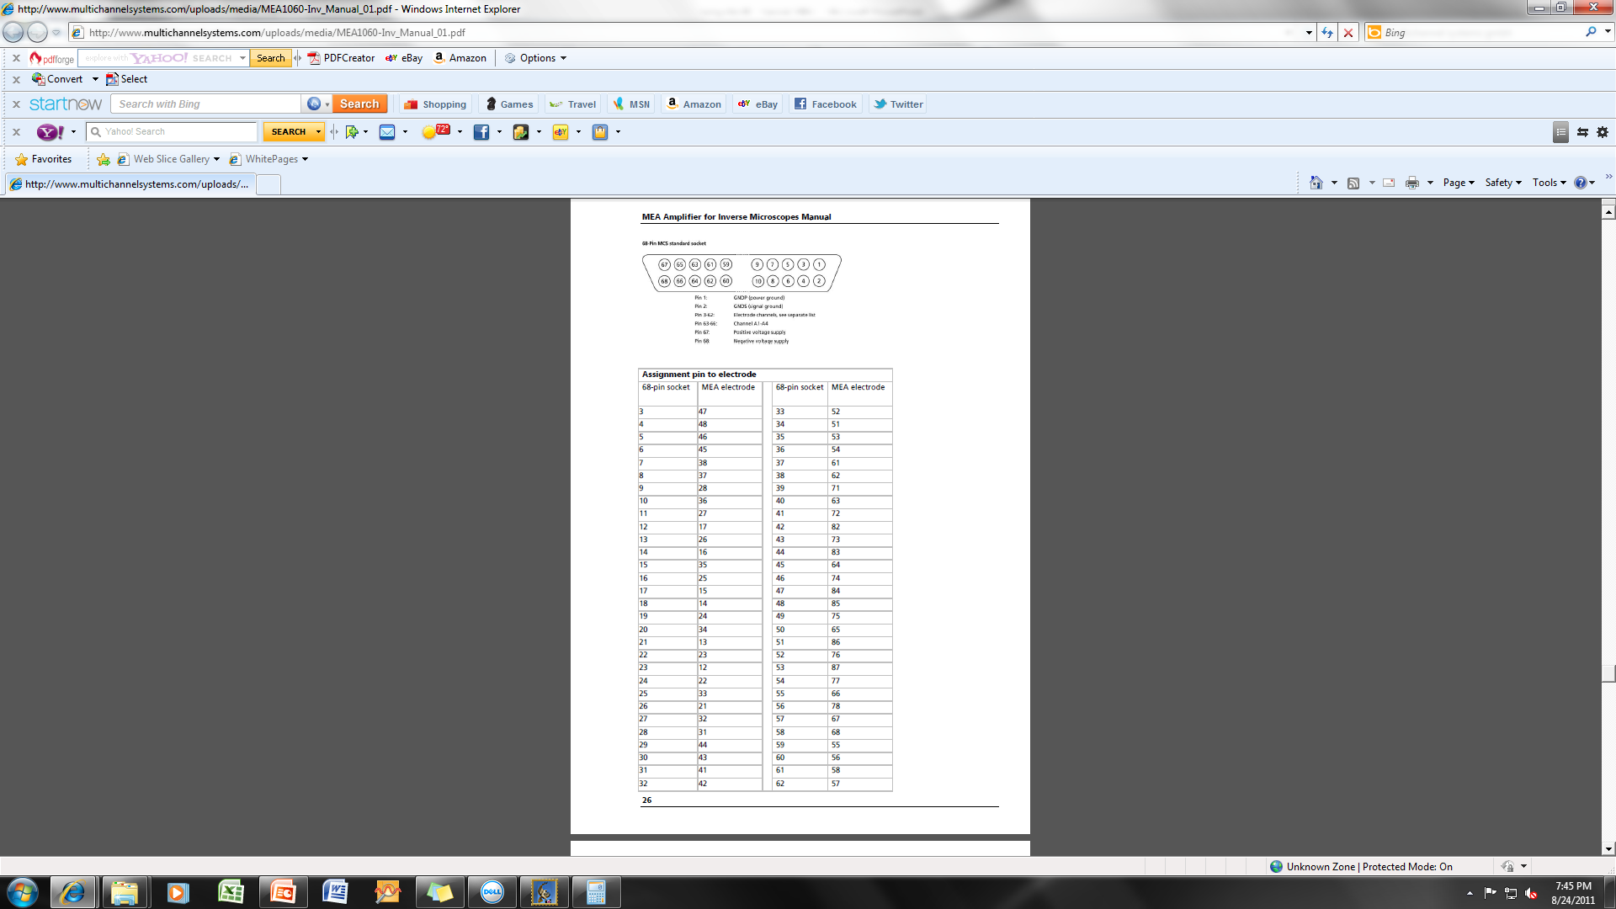
Multichannel Systems Amplifier and Signal Conditioner
Wiring Diagram
PS20W Power supply powers the MEA 1060-Inv amplifier

Slide 40
Raptor 4.4 Program Set-up
Raptor was created using LabView 2011 SP1
Raptor 4.4 was built from LV project 0805122.lvproj, testrecording080512, Hawkandlightnin2 Icon 48x48.
To rebuild an executable, the following modifications are necessary:
under “source file settings”, click testrecording080512 then click “customize VI properties,” then uncheck “run when opened,”
Under “advanced”, uncheck “copy error codes”

Slide 41
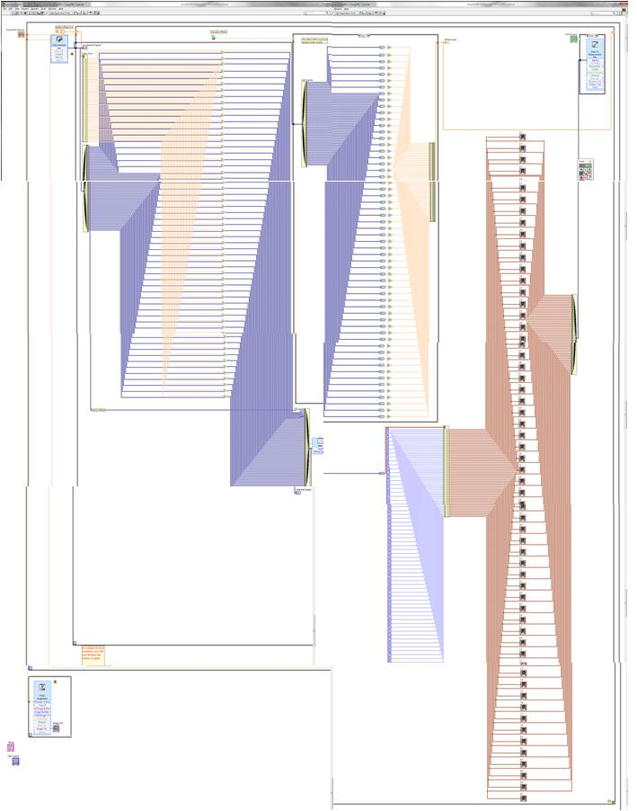
Block Diagram of Raptor 4.4
Data Written to .lvm file (tab-delimited text file) – there are now 2 of these – the second writes to TDMS files
Acquisition Time
DAQ Assistant
Background subtraction
Bandpass filter 0.5 – 200Hz
Front Page Graphs
Camera Control (IMAQ/Vision Express)
Stimulus program on next 2 slides
Tab Controls (for front page)

Slide 42
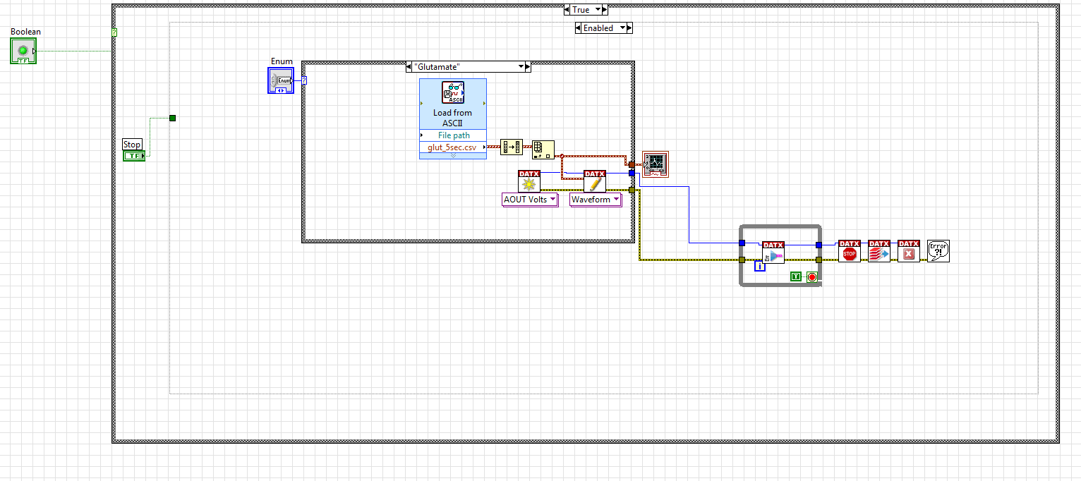
Stimulus Program Biological
There are 4 “Load from ASCI” subvi’s – one for each of the biological signals that are chosen within this case structure using the Enum control

Slide 43
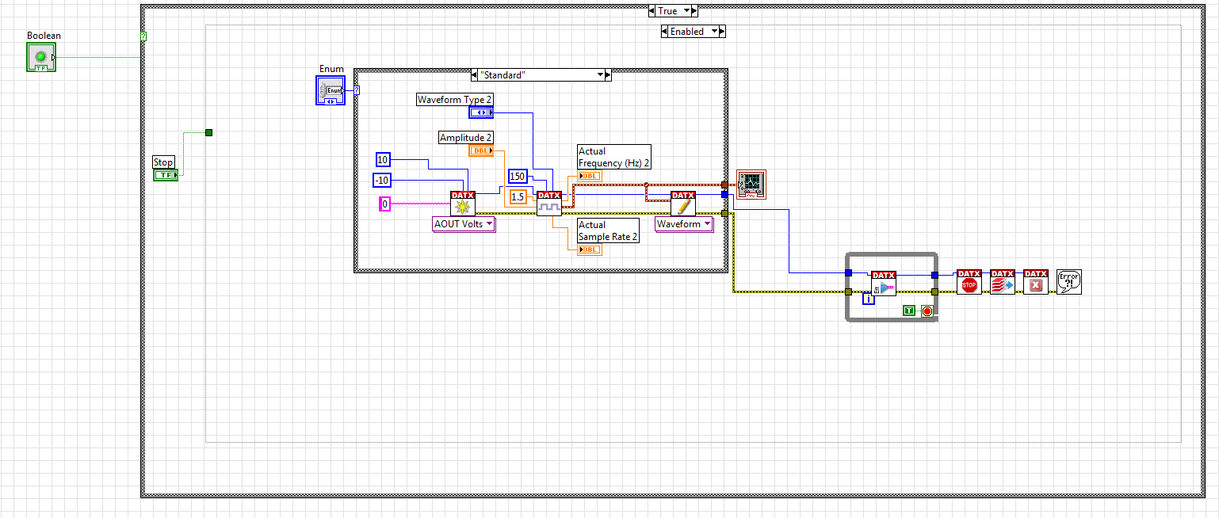
Stimulus Program Sine/Square/Triangle/Sawtooth

Slide 44
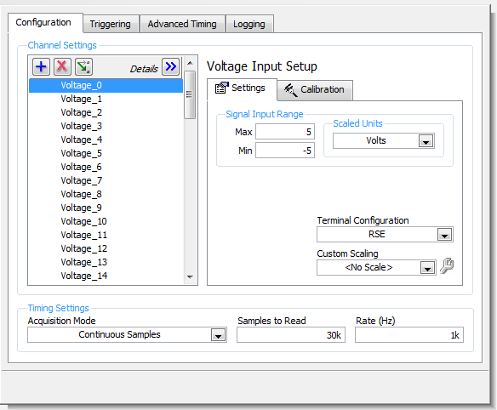
DAQ Assistant Set-up
Software triggering, internal clock

Slide 45
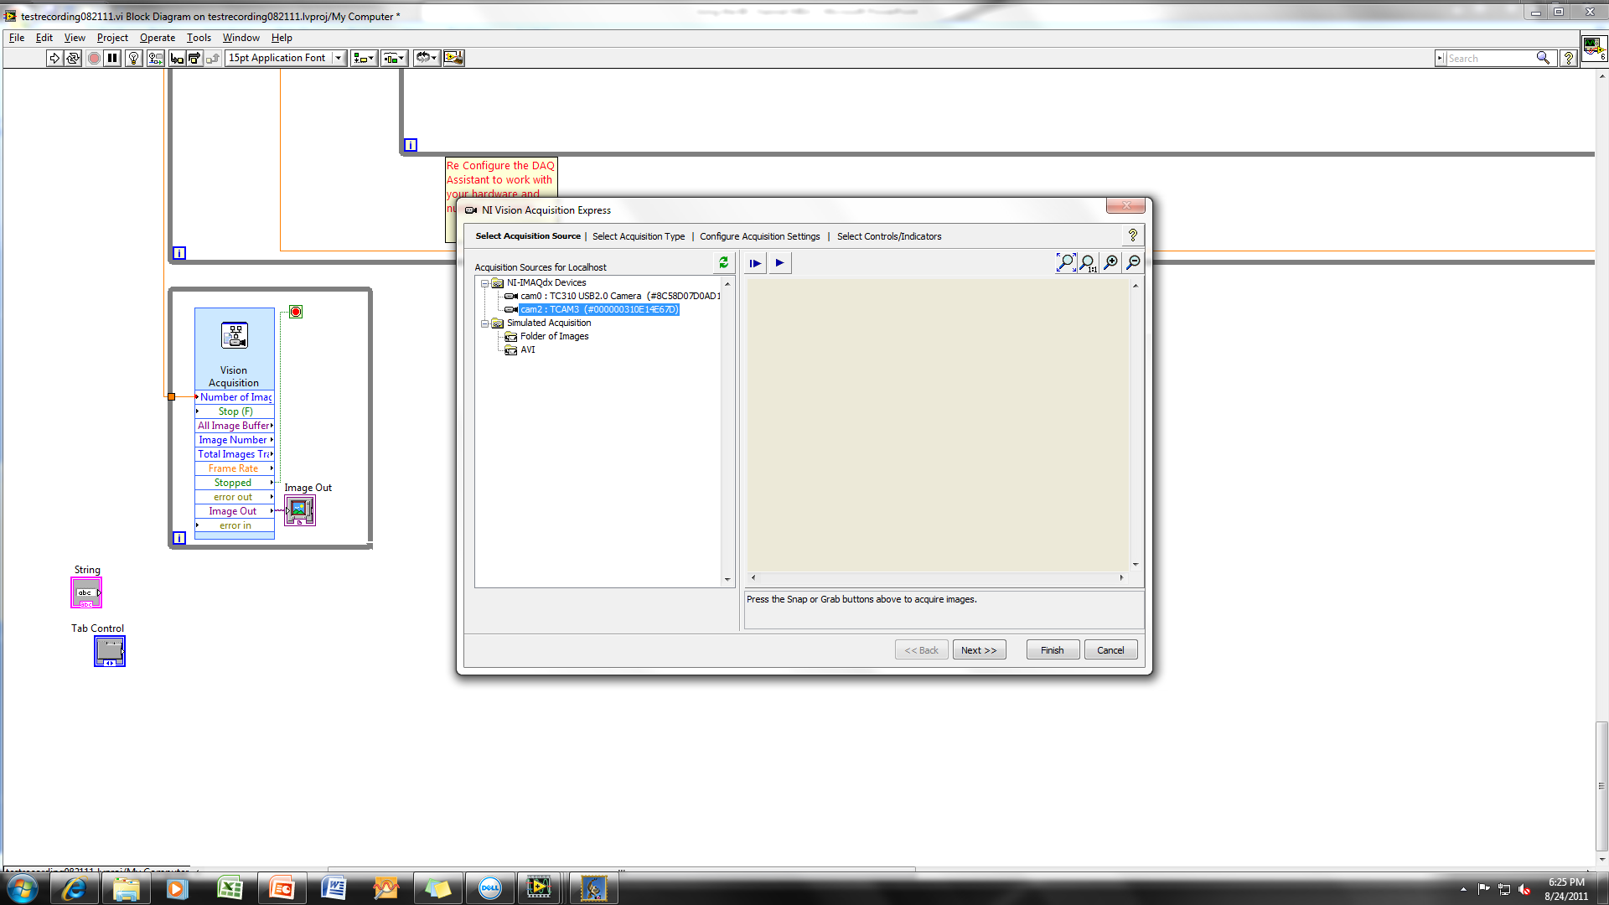
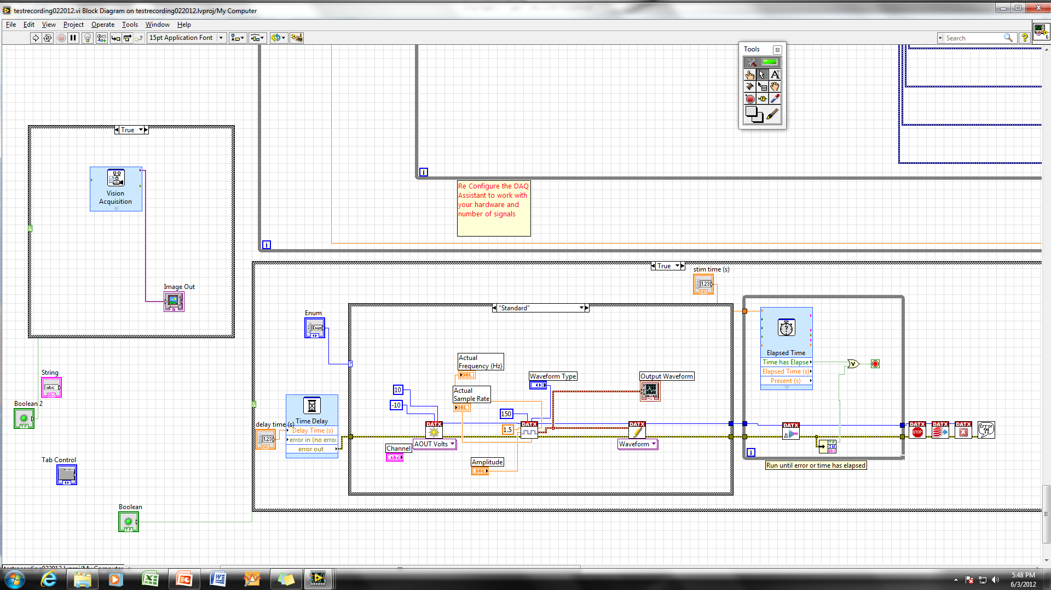
Camera Set-up (IMAQ/Vision Express)
Cam2: TCAM3 has Direct Show Driver
Raptor 4.4 will collect a single snapshot at start of data collection. Continuous collection can be added later, if needed.
Additional settings within Raptor 4.4 can be viewed by double-clicking on the Vision Acquisition subVi icon

Slide 46
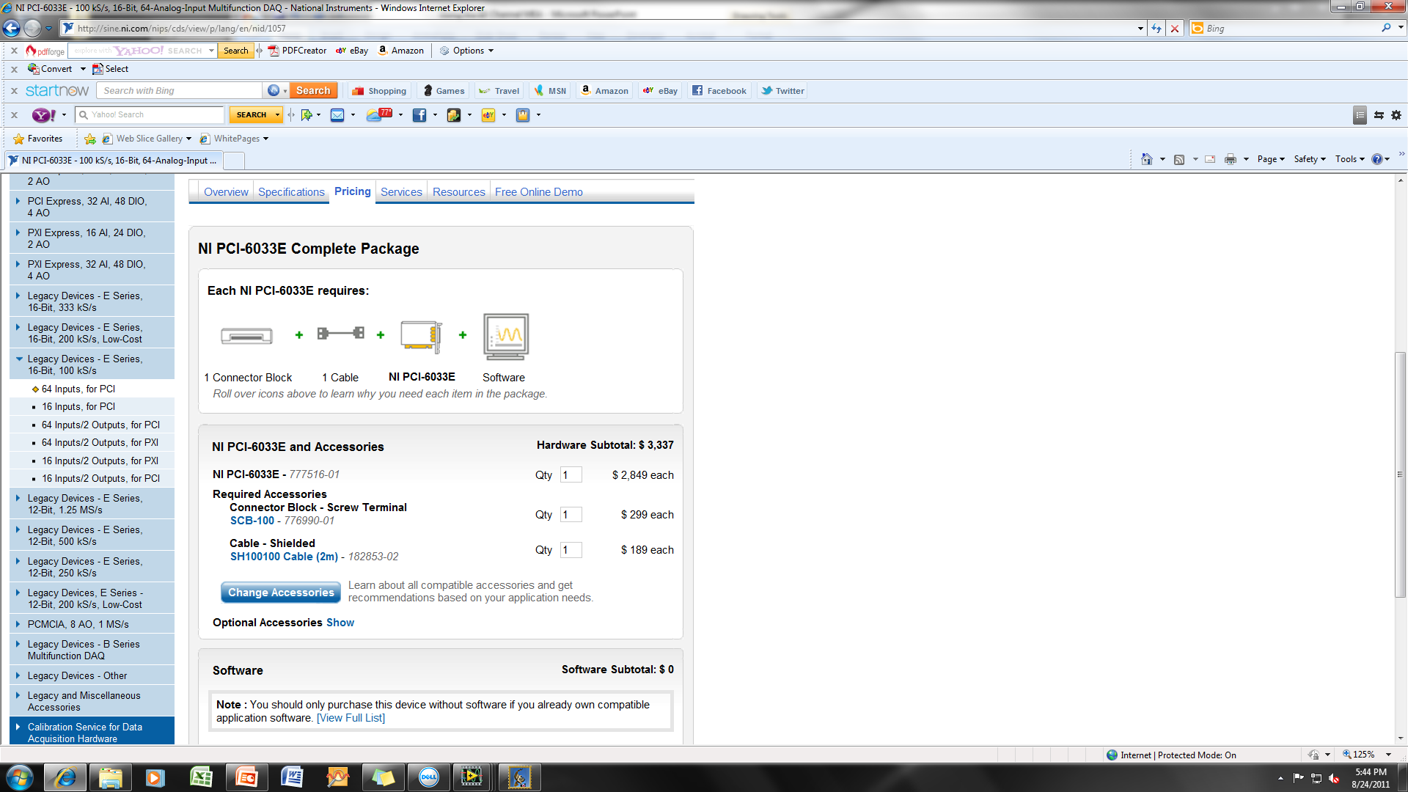
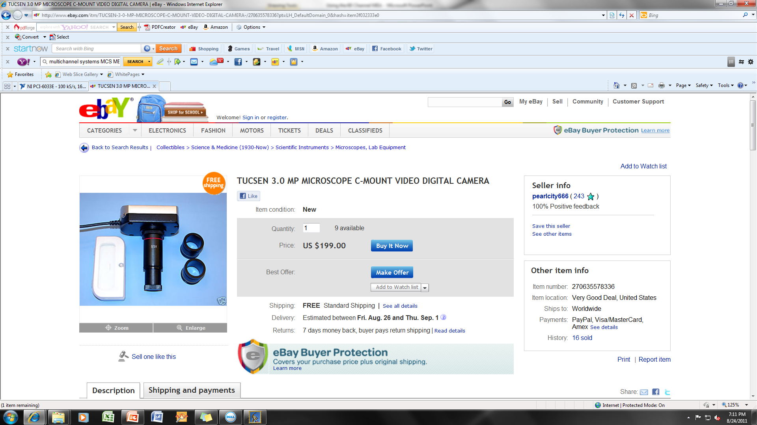
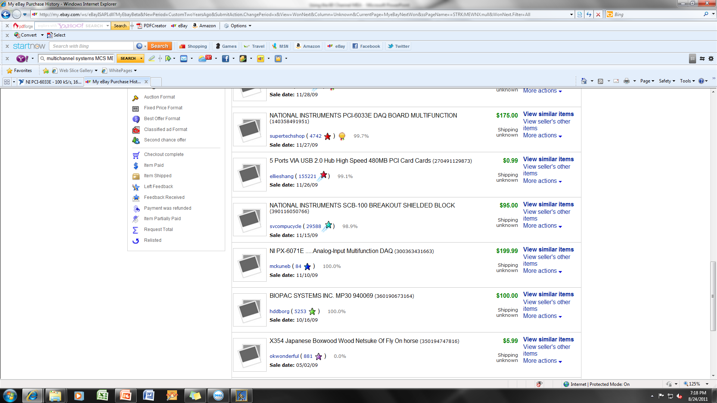
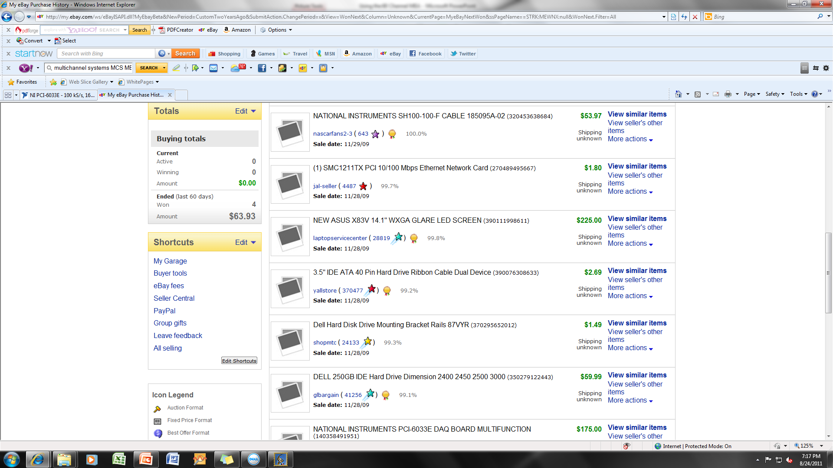

Estimated DAQ Hardware Cost (savings of $2798.03)
New
Used
Total: $3337.00 (without camera)
Total: $538.97
(includes camera)

